Slide 1
Consumer Behavior

Slide 2
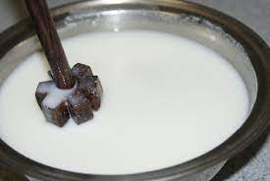

Earlier, liquid milk was churned into chaas, ghee, curd at home. Today's consumer, however, prefers to buy these products off the shelf.
AMUL primarily sell 95 % branded products, only 5 % is as commodity.
Of this 95 per cent, around 50 % comes from value added products like cheese, ghee, paneer etc.
Value added products offer more margins. For example, in comparison to the gross margin of
6.5 % in pouch milk
27.4% in ghee and skimmed milk powder 60 % in cheese and butter.

Slide 3
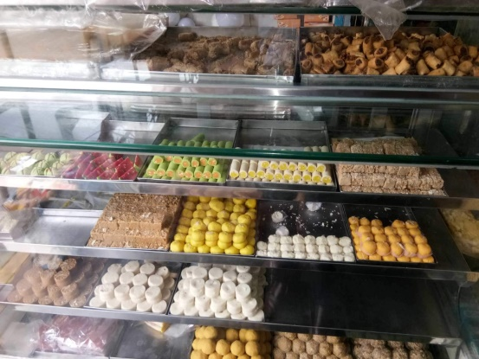
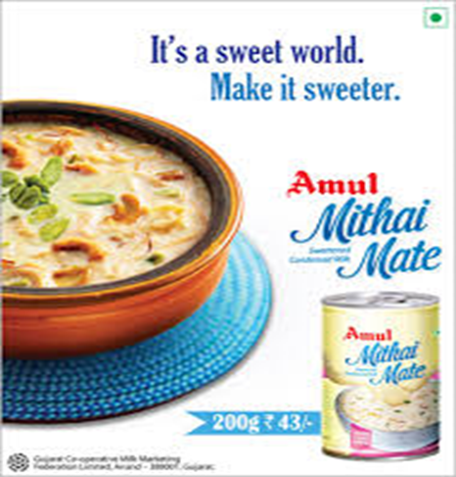
Amul -mithai market
Shift in consumer preference from loose 'mithai' to branded, packaged sweets.
Amul - packaged 'rasgullas' and 'rasmalais',
Amul realised that there is demand for hygienically prepared standardised sweets.”
"Chocolates are available at the corner store, but for sweets one has to visit a sweet shop.
“Almost, 50-70 per cent of sales of packaged sweets happen during festive season,” .

Slide 4
Definition of Consumer Behavior
Prof. Philip Kotler defines Consumer behavior as “the study of how individual, groups and organization
select,
buy,
use and
dispose
of goods and services, ideas or experiences to satisfy their needs and wants.”

Slide 5
Wal-Mart
Supermarkets from India and other countries that have build their businesses with a core proposition__________. DMart, Costco, Wal-Mart. Customer behaviour doesn’t change a lot as per geographies when you talk about shopping for daily needs. A majority of the customers across geographies seek ___________ in their daily shopping.

Slide 6
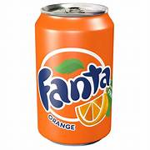

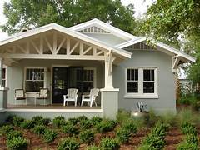
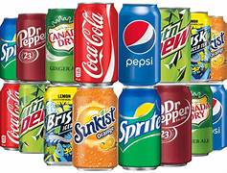
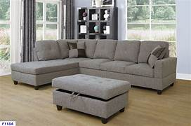
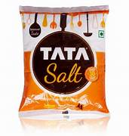

Slide 7
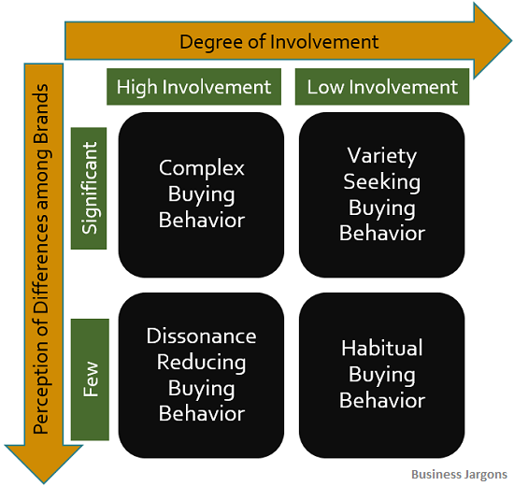
4 Types of buying behviour

Slide 8
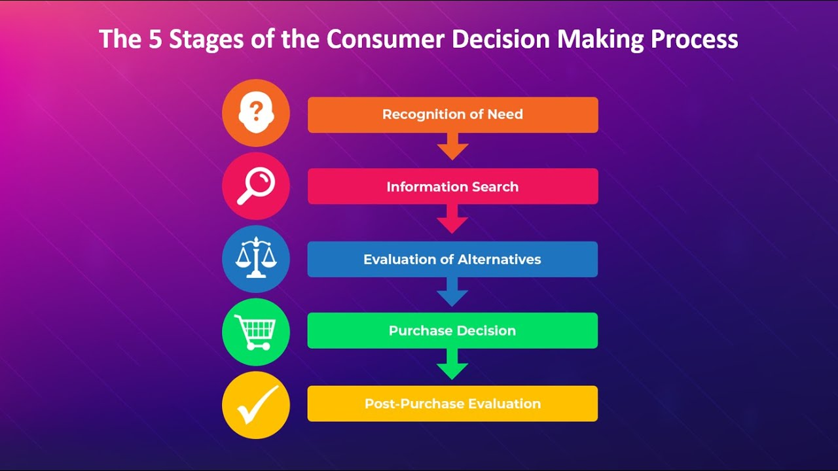

Slide 9
Marketing Research

Slide 10
Re (again) – search A systematized effort to gain knowledge. An original contribution to the existing stock of knowledge making for its advancement.

Slide 11
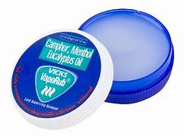
VICKS
Research conducted in Mumbai indicated that Indian mothers were worried about giving internal consumption medicine (Syrups and Tablets) to their kids as they felt that giving such medicines might negatively affect their child’s health. P & G used this piece of information to promote Vicks VapoRub, which could be applied externally to give relief from common cold.

Slide 12
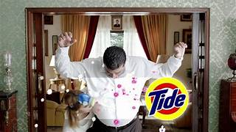
TIDE-In home visit- ODOUR
The company used in home visits to interview customers who had recently purchased a P & G product. Observation how they do daily chores (Eg. Washing clothes, utensils). Interview about, the purpose for which product was purchased, actual conditions under which the product was used, problems encountered. Could suggest modifications, attributes desired from product.
When P&G was exploring Eastern European Market they observed that most of the flats in the region were small, P&G researchers also noticed that in many cases the bathroom was adjacent to the living room, and the smell of laundry detergent permeated the flat when clothes were washed. Since inferior detergents, were being used, the odour was not only strong but offensive. During P&G’s research customers only articulated the need for good cleansing power but P&G realized that a pleasant fragrance was equally important.

Slide 13

P & G- Research Facility
P & G believes in the value of consumer ideas, so much that they have built a special facility to ensure the interaction is as dynamic and inspirational as possible. About 30 miles outside Cincinnati, inside a non descript building, P&G designed and created a typical consumers home and a store. Consumers are invited in to help P&G design new products and refine others that are already on the shelves. The consumers become participants to the point of having a shower and giving the product team feedback on the size and scent of soaps.

Slide 14

Maruti- Big Data The company added more than 1 lakh customers using Big Data analytics, Big Data analysis has helped spot trends and gain business insights for the auto major. 40% of Maruti’s customers are first-time buyers, 30% are replacement buyer customers while another 30% are looking for additional car. Data helps identify customers when they are ready for changing/upgrading an older car. The workshop data helps company spot accidental or damaged cars an opportunity for sales. Another example is spotting customers whose cars are more than 8 year old or when their children are college-goers providing opportunity to acquire another customer/second car.

Slide 15


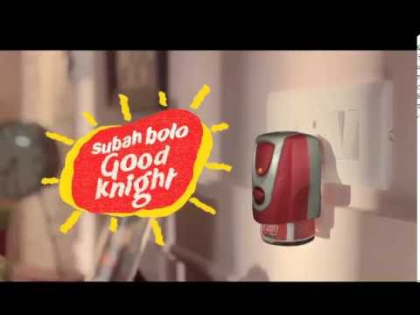

Based on that survey, the Good Knight Dengue Awareness Report, reveals that 85 percent of the respondents know dengue is a life-threatening disease, but around 92 percent population is unaware that day mosquitoes cause dengue. What’s even more startling is that 80 percent population agrees that mosquitoes are visible during the day but only 8 percent use any repellent format during daytime. With the new campaign 'Subah bolo Good Knight', Godrej's mosquito repellent brand Good Knight creates an effective case for itself by urging consumers to use the product during daytime to prevent dengue.

Slide 16
Research Process
1 Formulating research problem
2 Literature review
3 develop working Hypothesis
4 Preparing Research Designs
5 Collecting the data
6 Analysis of data
7 Hypothesis testing
8 Generalizations and interpretations
9 Preparation of the report

Slide 17
Physical science
____________________
Social science
_______________________________________
Length Preference Happiness
Weight Attitude Creativity
___________________________________________________
Easy Very Difficult
Ratio Ordinal Interval Nominal

Slide 18
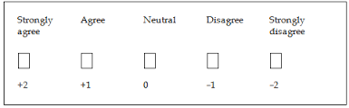
Likert (summated scale)

Slide 19
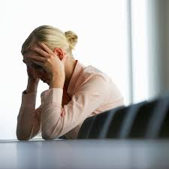
Projective Techniques

Slide 20
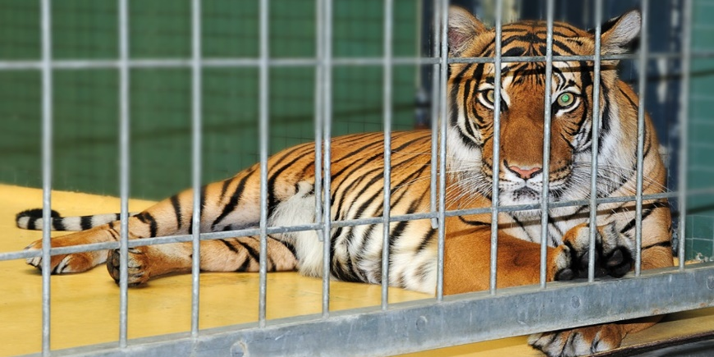
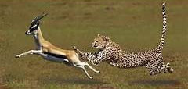
Marketing Research
If you want to learn how a lion hunt/lives, don’t go to the ZOO, go to the jungle.
Study as a person not as a respondent
Research that connects with the inner life of the customer not as a statistical construct.

Slide 21
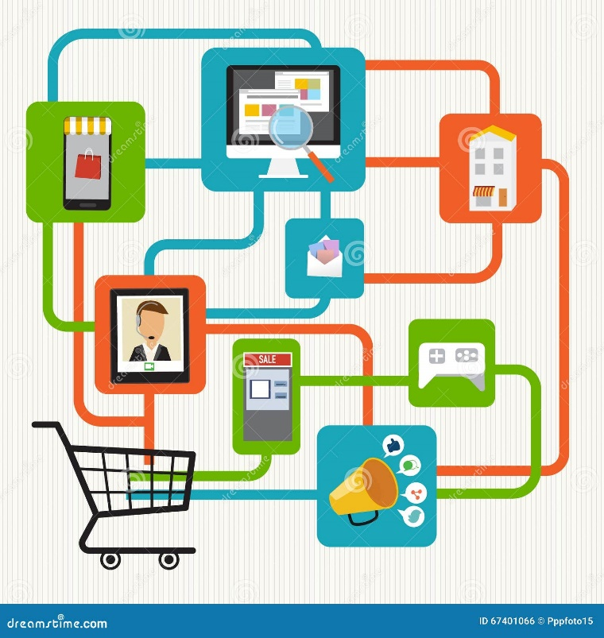
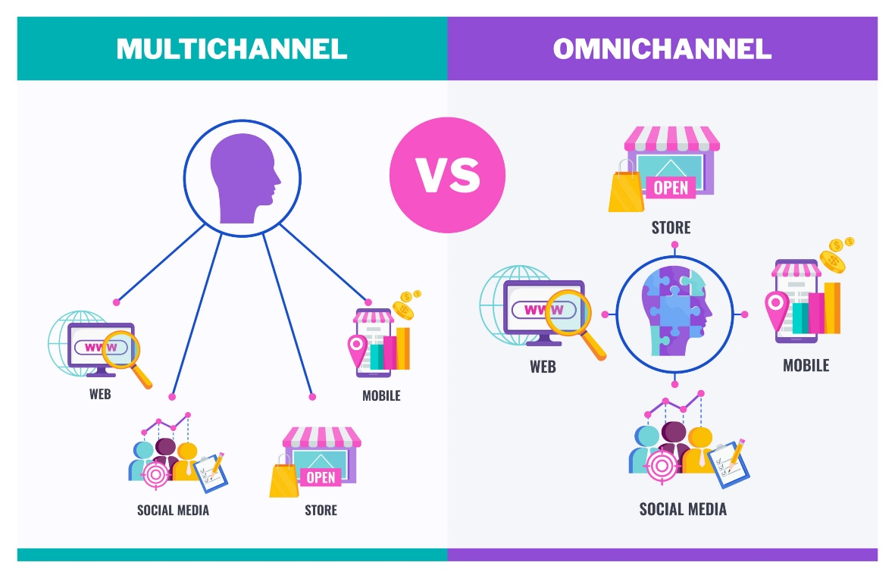
What is Omnichannel (O+O)
The prefix “omni” means “all,” and “channel” is a reference to the many ways customers might interact with a company—in physical stores, by surfing the web, on social media, and in emails, apps, SMS, and other digital spaces.
Integration of all physical channels (offline) and digital channels (online) to offer a unified customer experience

Slide 22
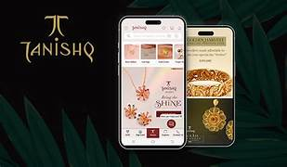
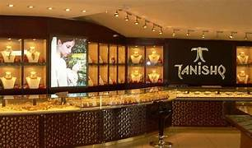
Online sale accounts for 10% of all orders
90% is leads generated online but concluded during in-store visits
Tanishq’s website generates 80,000 leads per month while around 1,000 chats are initiated daily on its platform
Last Year, 2-2.1 million monthly unique visitors on site, now 3 million
Reported sales of ₹24,313 crore in the last fiscal year. Omni-channel sale for Tanishq stood at ₹1,100 crore in FY22
The company actively pursues online orders and direct shoppers to nearby stores to conclude purchases
Covid prompted shoppers to turn to online purchases
Indian consumers typically buy light-weight and small-ticket jewellery on the internet
Online jewellery purchases have risen , the average ticket size remains flat and shoppers prefer pieces of 5-10 grams

Slide 23
Transfer Transaction Relation
Transactional Marketing is amongst the different marketing strategies that emphasize maximizing the sales volume and revenue of the firm.
On the other hand, Relationship Marketing is concerned with building long term relationships with customers.
Transfer emphasizes the act of moving something from one place to another.
Transaction involves an exchange, often including financial elements.

Slide 24
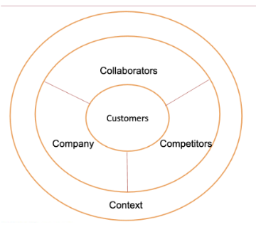
4/5c Framework

Slide 25
4/5c Framework
Customers | Whose needs company intends to fulfil
Competitors | Aims to fulfil the same needs of the same target customers
Collaborators | That help the company to fulfil the needs of the customers
Company | That develops and manages the offering
Context | That will affect how the company develops and manage the offering

Slide 26
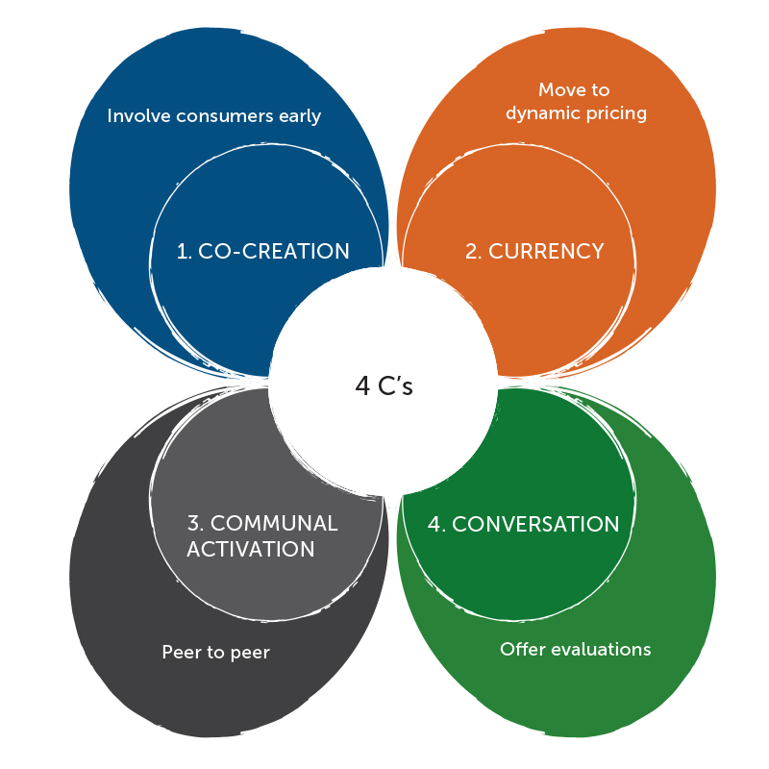
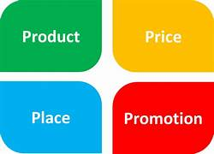
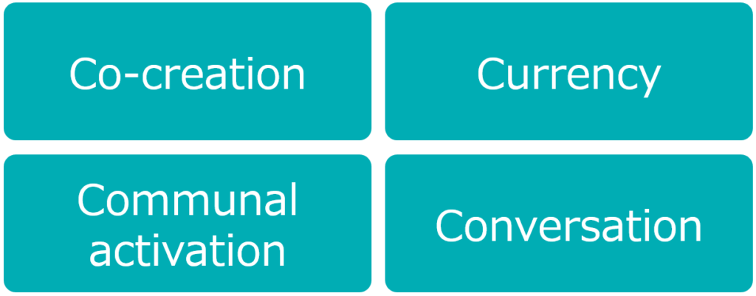
New 4C’s Framework Shift in the current marketing landscape

Slide 27
Traditionally, consumers are passive objects of selling techniques. In a connected world, the idea is to have both sides active.
In a connected world, the concept of marketing mix has evolved to accommodate more consumer participation. Marketing mix (the four P’s) should be redefined as the four C’s (co-creation, currency, communal activation, and conversation).
1 Connect and Develop: In the digital economy, co-creation is the new product development strategy.
2 Currency: The concept of pricing is also evolving in the digital era from standardized to dynamic pricing. Dynamic pricing—setting flexible prices based on market demand and capacity utilization—is not new in some industries such as airlines. But advancement in technology has brought the practice to other industries. Online retailers, for instance, collect a massive amount of data, which allows them to perform big-data analytics and in turn to offer a unique pricing for each consumer. In the digital economy, price is similar to currency, which fluctuates depending on market demand.
3 Community Engagement: The concept of channel is also changing. In the sharing economy, the most potent distribution concept is peer-to-peer distribution. Players such as Airbnb disrupting the hotel industry. They provide consumers easy access to the products and services not owned by them but by other consumers. In a connected world, consumers demand access to products and services almost instantly, which can only be served with their peers in close proximity. This is the essence of communal activation.
4 Conversation: Traditionally, promotion has always been a one-sided affair, with companies sending messages to consumers as audiences. Today, the proliferation of social media enables consumers to respond to those messages. It also allows consumers to converse about the messages with other customers. The rise of consumer- rating systems such as TripAdvisor and Yelp provide a platform for consumers to have conversations about and offer evaluations of brands they have interacted with.

Slide 28

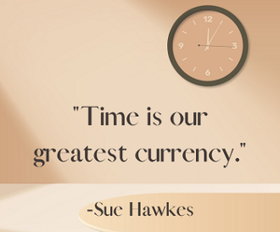



D Mart Competitor
How can you make customer spend more time in your showroom (CAR)?
MORE TIME SPENT MORE MONEY SPENT

Slide 29
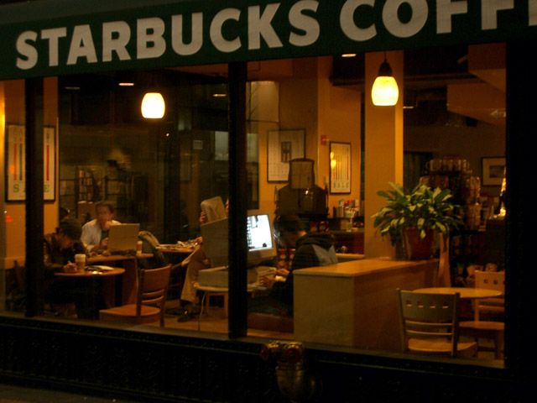
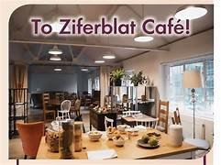
Time as Currency
Customer spending more time at home or in market?
Attention is scarce

Slide 30
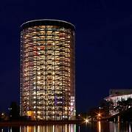
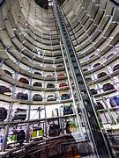
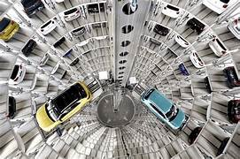
Autostadt volkswagon

Slide 31
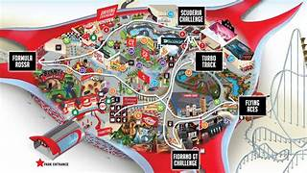
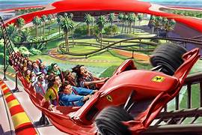
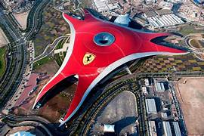
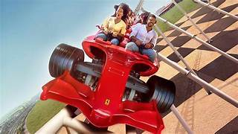
Ferrari world

Slide 32
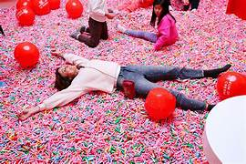
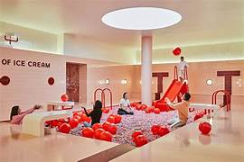
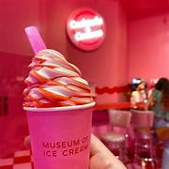
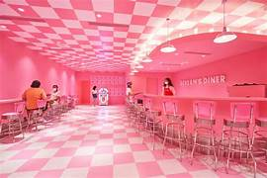
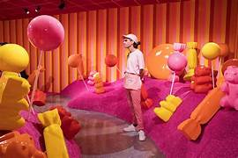
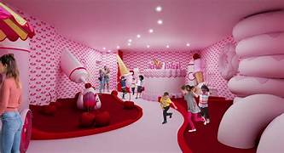
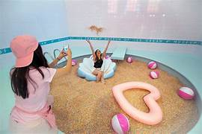
Museum of Icecream

Slide 33
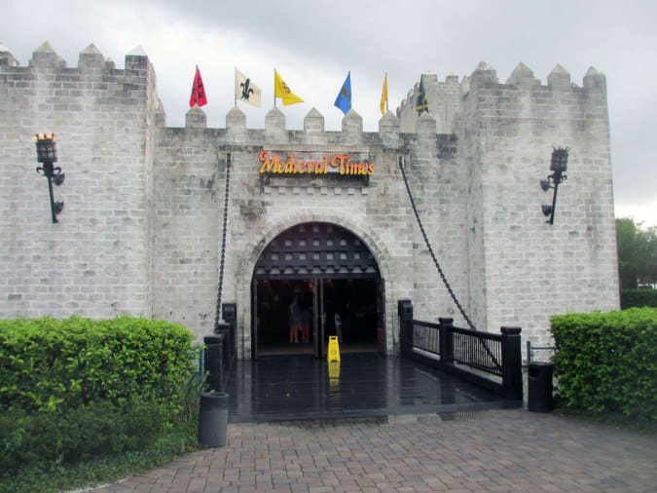
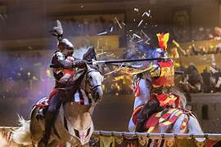
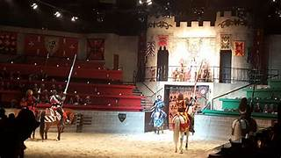
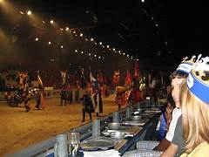
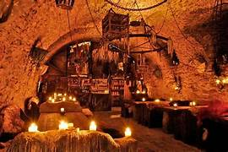
Theme the Experience
Medieval Times Dinner & Tournament is a fun family dinner theater themed as a royal banquet and tournament of jousting, sword fighting, and games of skill.

Slide 34
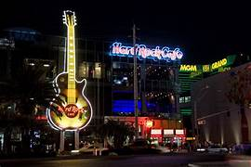
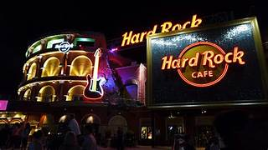
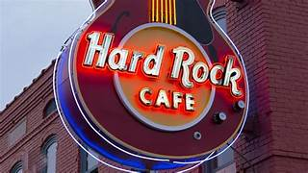


Hard Rock Café- chain of theme restaurants, memorabilia shops, casinos and museums

Slide 35


Slide 36
Experience Economy

Slide 37



3rd
Place
Socialization in US
It takes a true commodity UNROASTED COFFEE BEANS worth a mere 2 or 3 cents per cup, and turns into an experiential offering worth
$3, ….$10
Is your customer increasing or decreasing time spent with you?
Do you have to do more marketing or experience create demand entirely?
Is money derived entirely from sale of commodities, goods, services or from charging the experience?

Slide 38


Slide 39


Slide 40


Slide 41


Slide 42


Slide 43


Slide 44
Staging experience is not about entertaining, its about engaging
An experience may engage guests on any number of dimensions
The first dimension on horizontal axis corresponds to the level of guest participation.
At one end of the spectrum lies passive participation in which the customer do not directly affect or influence the performance. Such participants include symphony goers, who experience the event purely as observers or listeners.
At the other end of spectrum lies active participation, in which customers personally affect the performance or the event that yields the experience. Active participants include skiers, who participate in creating their own experience.
The second vertical dimension of experience describes the kind of connection or environmental relationship, that unites the customers with the event or performance.
At the one end of spectrum lies absorption occupying a person’s attention by bringing the experience into the mind from distance.
At the other end is immersion, becoming physically or virtually a part of the experience itself.

Slide 45
The coupling of these dimensions defines 4 Realms of an experience
ENTERTAINMENT:
The kind of experiences most people think as entertainment occurs when they passively absorb the experience through their senses, as generally occurs when they view a performance, listen to music or read for pleasure.
But even though many experiences entertain, not all of them are.
They are not doing anything except responding to the experience, enjoying , laughing.

Slide 46
The coupling of these dimensions defines 4 Realms of an experience
ESTHETIC:
Create an ATMOSPHERE in which your guest feels free to be.
In such experiences, guests are immersed in an event or environment but have little or no effect on it, leaving the environment but not themselves essentially untouched.
Rainforest CAFÉ: A wild place to shop and Eat is not to stimulate the experience of being in a Rainforest. Rather it aims to stage certain esthetic experience that is the Rainforest café.
FAKE-Honest-NON REAL
Rainforest is not the rainforest, They don’t try to fool their guests ino believing its something it is not.
IT’s TRUE to itself.

Slide 47
The coupling of these dimensions defines 4 Realms of an experience
EDUCATIONAL:
WHAT do you want the student learn from the experience?
Involves active participation of the individual, Guests, student absorbs the event unfolding before him. To truly inform people and increase their knowledge or skills, educational events must actively engage the mind-intellectual or body- physical training.
Focus teacher, focus student, active student, interactive student.

Slide 48
The coupling of these dimensions defines 4 Realms of an experience
ESCAPIST:
A person who seeks distraction and relief from an unpleasant realities especially in the form of get out of captivity.
Habitual diversion of mind to purely imagination
A person who escapes into the world of fantasy
It’s a mental diversion /avoidance from unpleasant aspects of life
A computer based game let the average person feel what its to be a SUPERSTAR
Involves much greater immersion than entertainment and educational experiences. Escapist experiences are polar opposite of pure entertainment.
COMPLETELY immersed in them as actively involved.
Involves ARTIFICIAL activities
TREKKING in theme park, GAMBLING in casinos, Playing Computer Games, Chatting Online

Slide 49
All reals are always present to varying degrees in any experience, and the most robust experience are those that hit the SWEET SPOT in middle of the 4 Reals drawing richly from each, sets flow- the optimal experience.
When you are in flow, you are both fully immersed in the experience while absorbing its challenges, you are actively responding to what is going on around you while remaining passively mindful of the activity as a whole.

Slide 50
5A’s Framework

Slide 51


Slide 52


Slide 53


Slide 54

Advertising
I don’t know-I know it
I like it I want it
Right now

Slide 55





Slide 56
Centre Shock
Zoozoos
Cadbury
M-Seal
Cadbury SILK

Slide 57

5A’s Framework
AWARE | I Know | Customer comes to know about brand
APPEAL | I love / Interesting | Need to create curiosity
ASK | I research | Customer starts researching the brand, seek information from multiple sources
ACT | I will buy | Once satisfied with the brand, they will buy
ADVOCATE | I recommend | Loyal customer spreads the word

Slide 58


Slide 59
Thank You

